Slide 1

Team Innvotec Presents You IVector
Product Owner: Pavan Kumar K S
Scrum Master: Priyanka Sharma
Team:
Manjushree,
Parijat Das
Priyanka Sri Ramasetty,
Rani Bishnoi,
Jai Santosh Mandava,
Yashaswani Bommanayakanahalli Mahalinga P
Under Guidance of Prof. Son Nguyen

Slide 2
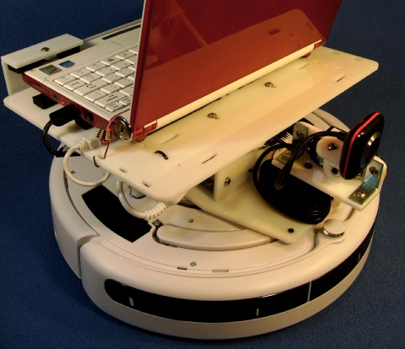
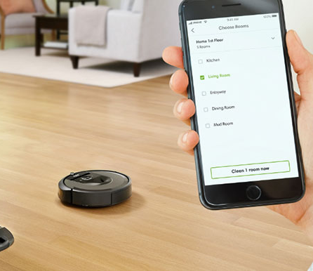
IVector AND SMART IOT CONNECTIONS
i-Vector is basically a machine mediator which is designed to connect and communicate with other devices in addition to smart cleaning of the rooms.

Slide 3

Product Vision and Sales Pitch
Vision:
IVector is basically a machine mediator which is designed to connect and communicate with other devices in addition to smart cleaning of the rooms.
Sales Pitch:
Make people’s life better with our product.

Slide 4
System Block Diagram

Slide 5
IVector and IOT
How IoT technologies can facilitate i-Vector interaction with the human at functional and social level.
Functional pervasive IoT sensors can make the functional means of i-Vector interaction more robust.
Social body cues like gestures, voice or face expression can be used to estimate the user’s emotional state and make the i-Vector respond to it.
Tele-interaction in i-Vector have also been used besides IoT technologies for remote interaction, especially while out from home.

Slide 6
Automatic Sensors, Batteries and Bluetooth
Detects the changes in the ambient conditions and records it.
Yield of the sensors is measured when the amount of data sensed changes = sensor affectability.
Types of sensors used :
IR Sensors, LDR Sensors, Ultrasonic Sensors, Mapping Sensors
To monitor the i-Vector bluetooth is being connected through a mobile app
Smart batteries

Slide 7
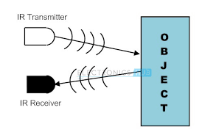
Types of Sensors
IR Sensors:
It has two main components
Belongs family of GP2Y0A21YK0F
Measures a distance 10-80 cm
LDR Sensors:
Light Dependent Resistor
Uses high resistance semiconductor material
Generates electron-hole pair;
Increases conductivity by reducing the resistivity.
Used for charging the battery if solar panels are mounted.

Slide 8
Types of Sensors
Ultrasonic Sensors
Apt for robotic applications
Have high and accurate ranging → 2cm – 4m
Obstacle avoidance
Mapping Sensors
Radio frequency transmitter and receiver
Old technology had no mental maps
Vision Simultaneous Localization and Mapping
Persistent mapping and remembers the plan or layout

Slide 9
Object Sensors
Object Sensors get activated when IVector bumps into an object and its bumper pulls back.
This will let IVector know that it has run into an obstacle and then it will pull itself back, rotates and starts moving forward till it finds a clear path.

Slide 10
Wall Sensors
Wall Sensors will be located on the right side of the bumper and it will let IVector know to clean very carefully along walls and around objects without touching them.
This means it can clean nearby any obstacle without bumping into it.

Slide 11
Cliff Sensors
Cliff sensors constantly send out infrared signals, and IVector assumes them to instantly rebound back.
If it is going near a cliff, suddenly the signals will get lost.
This is how IVector will get to know that it has to head another way.

Slide 12
Wheel Sensors
Wheel Sensors will measure wheel rotation or the wheel circumference so that it can get to know how far it has traveled.

Slide 13

Bluetooth:
To control through mobile app
Client-server architecture – personal area network
Speed 2.4GHz
Bluetooth – HC -06 – transparent wireless serial communication
Smart Battery
Charging is made automatic
Power saving mode
Solar panel installed onboard is case of emergency

Slide 14
Adaptive Navigation technology
Adaptive navigation is a group of technologies that support navigation in hyperspace, by adapting to the goals, preferences and knowledge of the individual user.
Utility of ANT:
Help the user achieve their goals faster
Reduce navigation overhead
Increase user’s satisfaction with the system

Slide 15
Mapping Technology
Mapping Technology is used so that the
i-Vector is be able to construct a map (outdoor use) or floor plan (indoor use) and to localize itself and its recharging bases or beacons in it.
Solutions:
Digital Maps in open format
Map Server
Online maps
Desktop Applications
Network Applications

Slide 16
Machine Learning and Computer Vision
Object Identification
Smart Schedule – ( Cleaning and System Maintenance)
Optimal cleaning path
Data analysis to determine the frequent need for cleaning
Quiet Hours

Slide 17


Slide 18
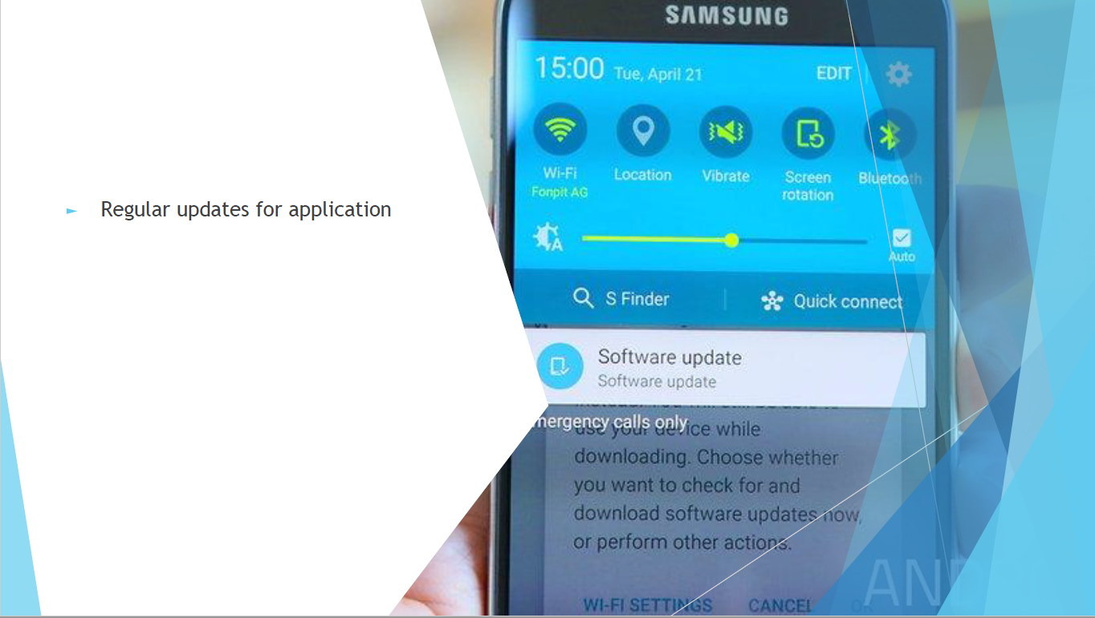

Slide 19
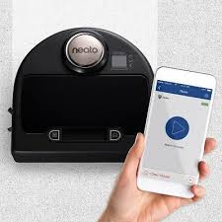
Modes of i-VECTOR
The product has several modes of operation (listed below). Each mode focusses on developing a unique functionality and capability. The modes are:
1. Smart cleaning mode
2. Outdoor mode
3. Deep cleaning mode

Slide 20


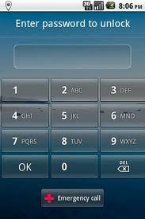
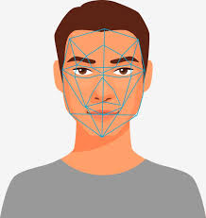
SECURITY for i-Vector
Double- authentication for login.
Facial Recognition
Voice recognition
Thumb print recognition
Pattern input

Slide 21
Automated notification system for unrecognized connection/activity.
Self turn-off mode when not in use.
Recommends usage of strong and unique password.
Universal plug and play mode is turned off.
Security Continued…

Slide 22
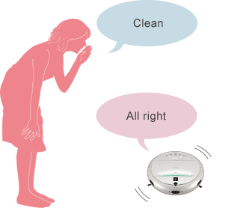
HOW VOICE RECOGNITION FEATURE WORKS IN IVECTOR
Installing an app on your smartphone and connecting it with Alexa or google home
Provide commands through an application or directly for the operation of Ivector
Ivector performs all the operations as specified
Figure[1]: Voice recognition feature for Ivector

Slide 23

VOICE RECOGNITION
It can be used:
To start and stop the operation of Ivector.
To schedule the working of Ivector.
To clean the dirt immediately, Ivector can be set up using this feature.
To remove dirt from surfaces like blankets and carpets, Ivector works very effectively.

Slide 24
ADVANTAGES OF VOICE RECOGNITION IN IVECTOR
Ivector can be operated anytime and from anywhere.
Ivector performs all operations through the commands received.
The commands can stored and used as and when necessary which makes it efficient in terms of time perspective.
UPDATES AND UPGRADES
Auto disposal of the waste through the voice recognition
inculcate detection of a specific person’s voice for security purposes

Slide 25
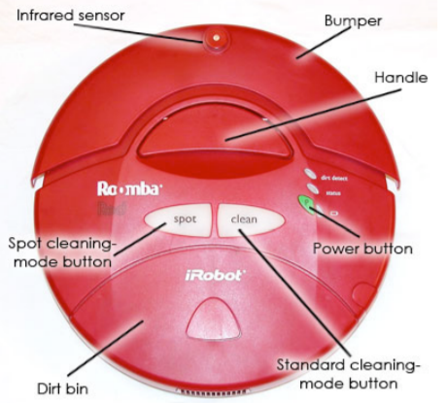
Physical/ Implementation View
Buttons:
Power Button
Spot Cleaning Mode Button
Standard Cleaning Mode Button
Self-Charger Point
Battery
Tracked Wheels
Bumper

Slide 26
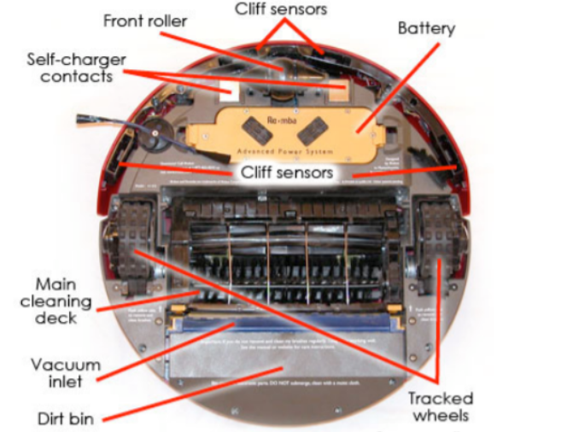
Physical/ Implementation View
Motors
One driving each wheel (2 total)
One driving the Vacuum
One driving the spinning side brush
One driving the agitator assembly

Slide 27
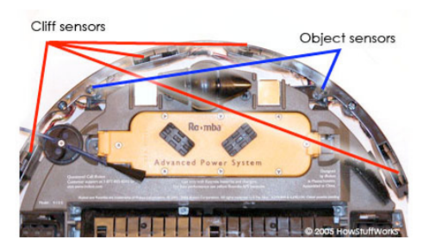
Cliff and Object Sensors

Slide 28
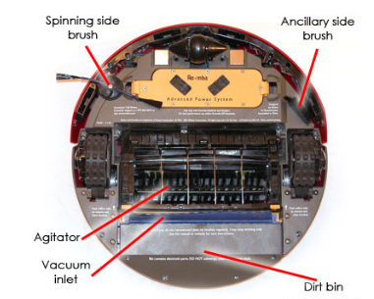
Cleaning System Parts
Main Cleaning Deck
Front Roller
Cleaning System Parts
Agitator
Spinning Side Brush
Ancillary Side Brush
Vacuum Inlet
Dirt Bin
Handle

Slide 29
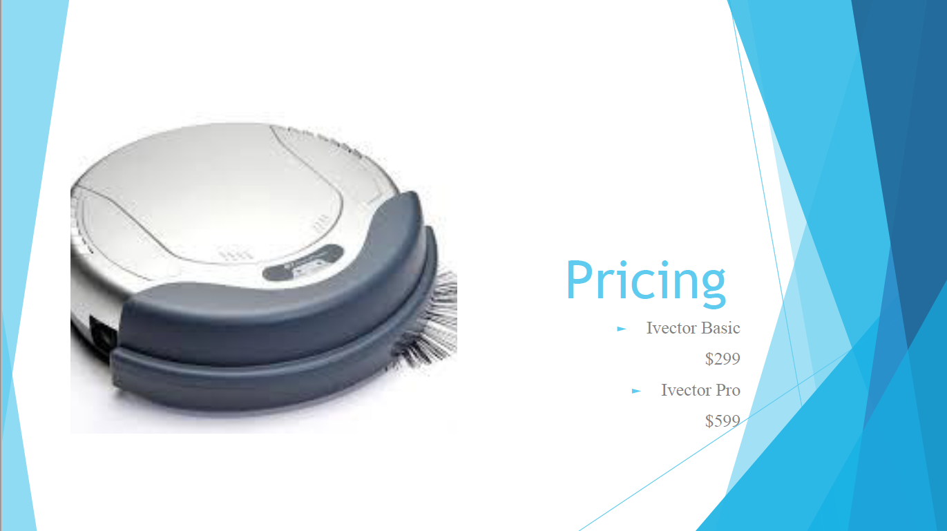

Slide 30
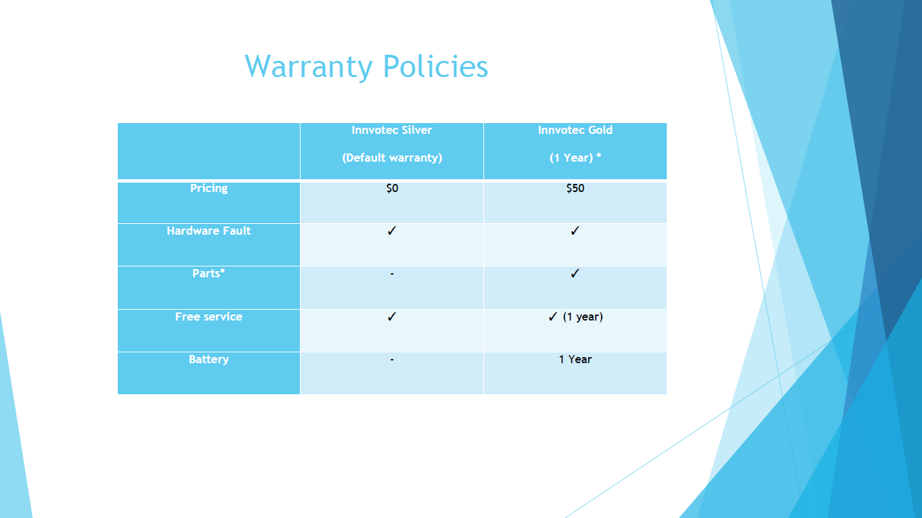

Slide 31
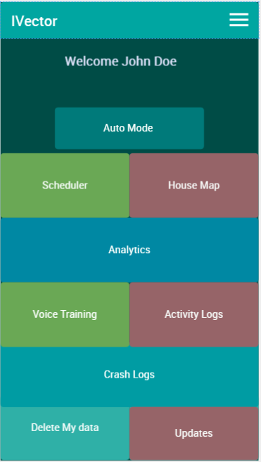
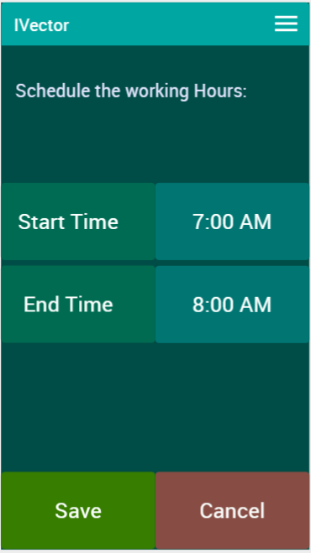
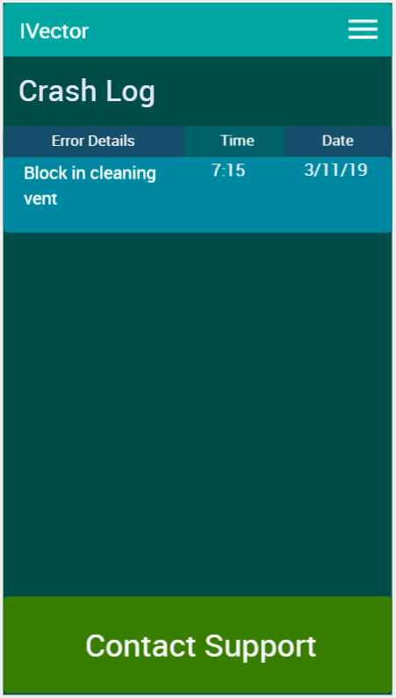
Wireframe Mockup

Slide 32
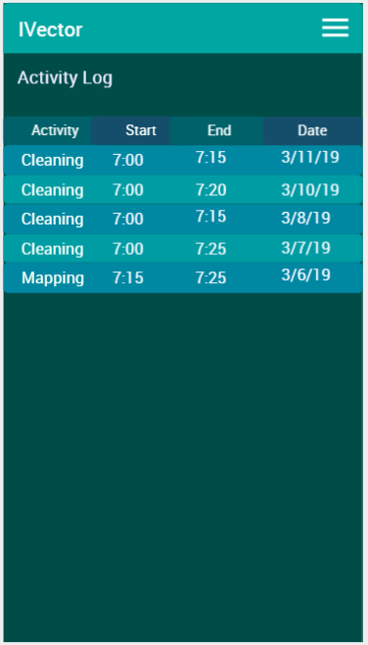
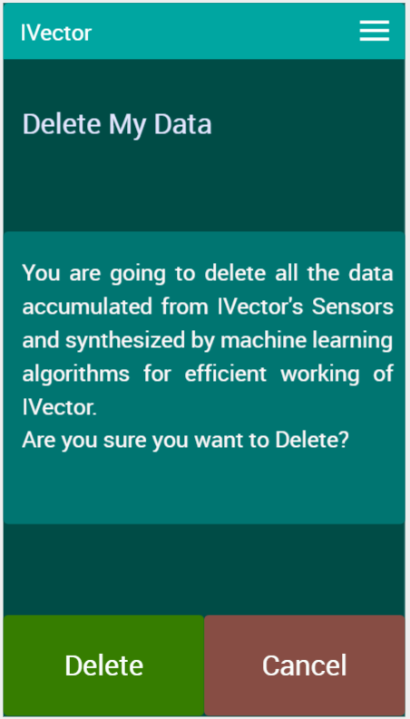
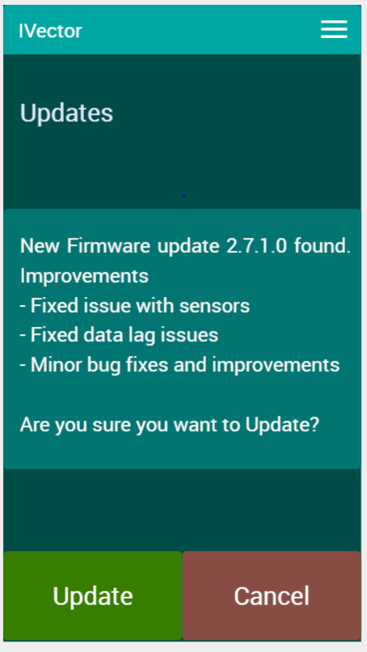
Wireframe Mockup
Wireframe Mockup

Slide 33
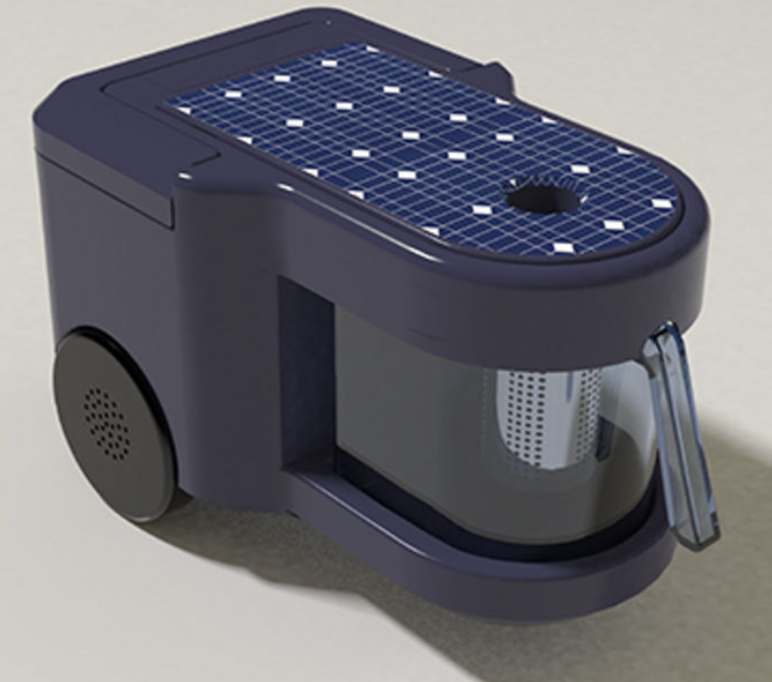
Future updates in IVector
SOLAR ENERGY
Built in charge controllers.
Portable battery.
Charging control system between solar plate and battery.
Multiple uses of battery.

Slide 34
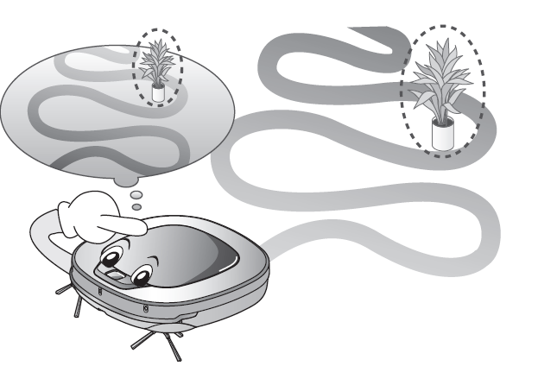
Updates in cleaning modes
Manual cleaning mode
Spot cleaning mode
Turbo mode
Repeat mode
Learning mode

Slide 35
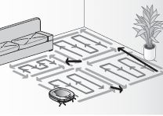
Smart cleaning
Scanning the space available for cleaning.
Creating floor plan.
Setting up cleaning zone parameters.
No go zone

Slide 36
Product Backlog -> What is the goal?
4 week sprint -> Time to achieve the goal
Task Analysis -> Know your work before you start
Mid sprint overview -> Where do we stand ?
Daily 15mins scrum –> Let’s get connected
Sprint review -> Did we meet the goal?
Sprint retrospective -> What went wrong?
Process and Best Practices

Slide 37
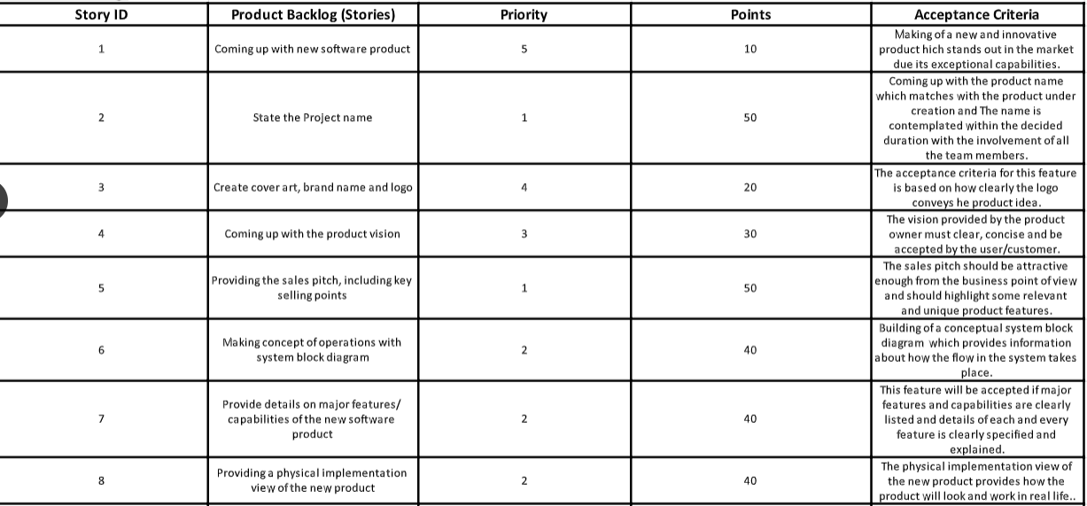
Product Backlog

Slide 38
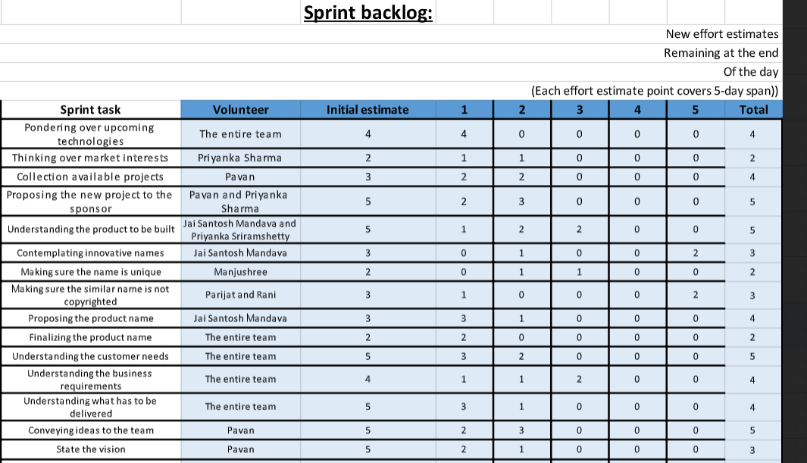

Slide 39
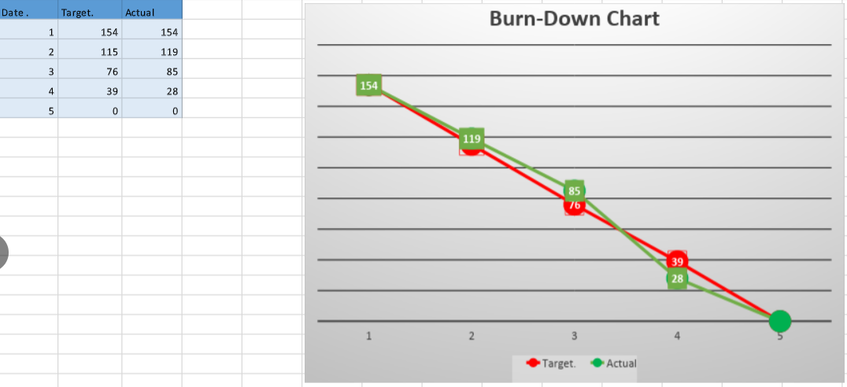

Slide 40
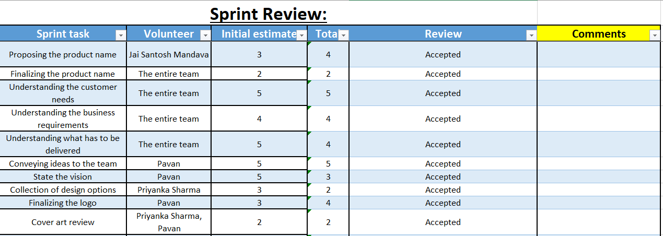

Slide 41
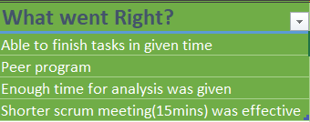
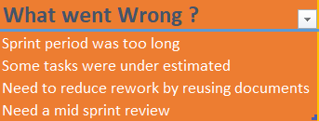
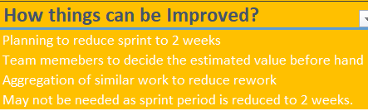
Sprint Retrospective Outcomes

Slide 42
Contact Information Talking to us is easy Call us1-866-693-9766 US based Helpline open: 8:00am - 8:00pm CST Monday to Friday 9:00am - 6:00pm CST Saturday
Help n Support Online: Troubleshooting Parts, tools and accessories Guides, tips and manuals Contact us : 1-657-448-9482 | Register your i-Vector Register your warranty Registration for business users Contact us: 1-714-726-8426
Help from i-Vector experts Repairs and servicing Find a Dyson Demo Store Contact us: 1-866-693-9766 | Email us : support@i-Vector.com

Slide 43
Thank You

